Slide 1
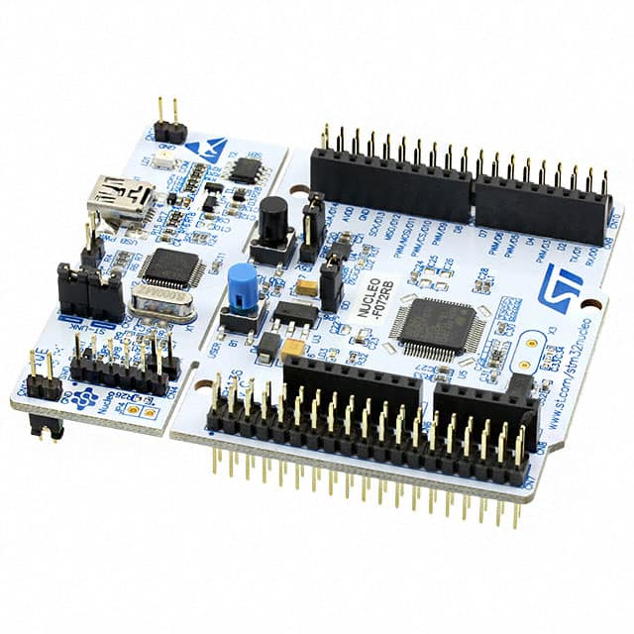
1、Desktop/Server:
x86/AMD64: Windows / Linux
multi processors/sockets
2、Embedded:
2.1 MPU: multi cores, Linux
Processor
2.2 MCU: single core, RTOS
Controller
Real Time Operating System
note: SOC - System On Chip
Adaptor:
power & communication
ST-Link
SWD – Serial Wire Debug
Notes:
2020-09-19

Slide 2
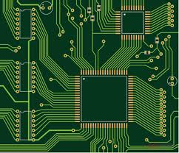
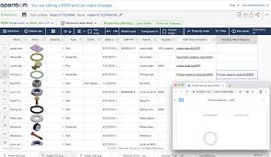
PCB - Printed Circuit Board
BOM – Bill Of Materials
Components to Order

Slide 3
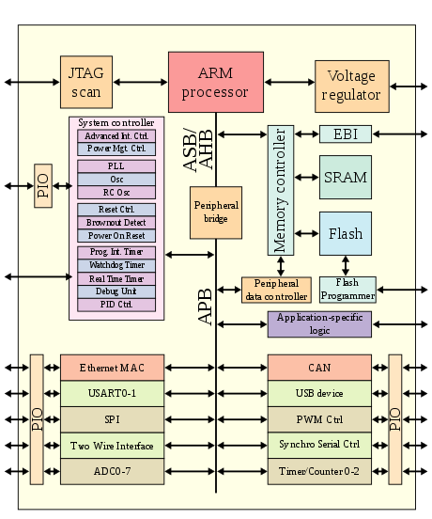
ARM architecture
CPU
Memory
IO
SOC - System On Chip
Hardware
Software
(Bootloader)

Slide 5
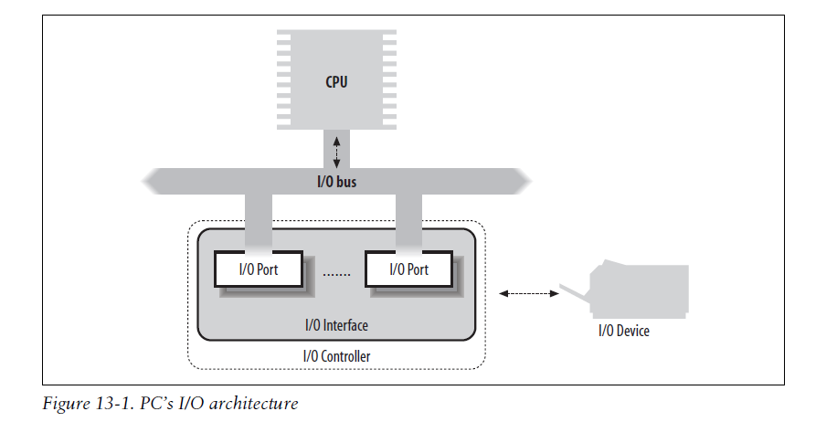

Slide 6
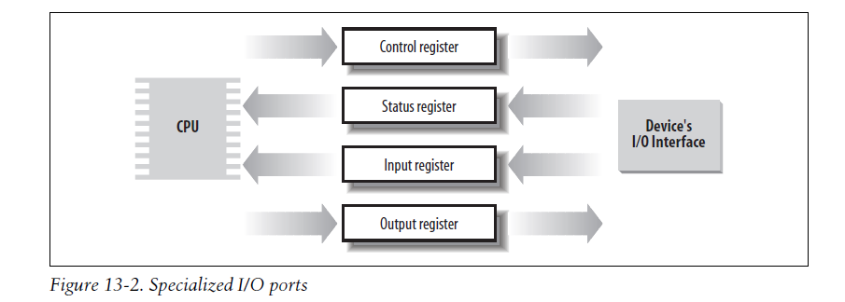
I/O Interfaces ports/registers/io mapped memory locations 计算机CPU端的
Interrupt vs Polling
Case by Case
Standard

Slide 7
Schematic 电路原理图
MCU
SOC
MCU
SOC
USB
Power
SWD/ST-Link/DEBUG
UART/COM4

Slide 8
Schematic 电路原理图

Slide 10
GND
3V3

Slide 11
Driver:
The Cortex microcontroller software interface standard (CMSIS)
HAL -- Hardware Abstraction Layer
LL -- Low-Layer drivers
C Programming

Slide 12
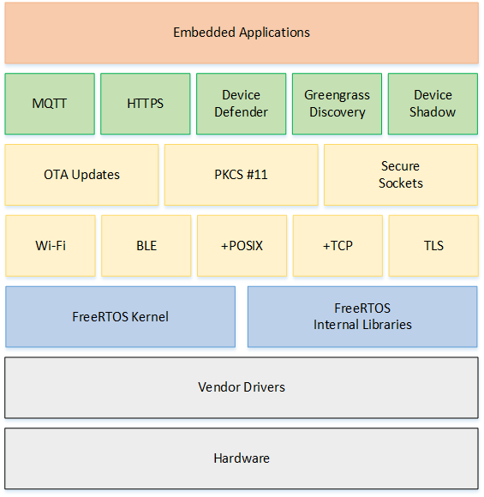
FreeRTOS
No Segmentation
No Paging
No Multi-user
No Terminal
Host/IDE

Slide 13
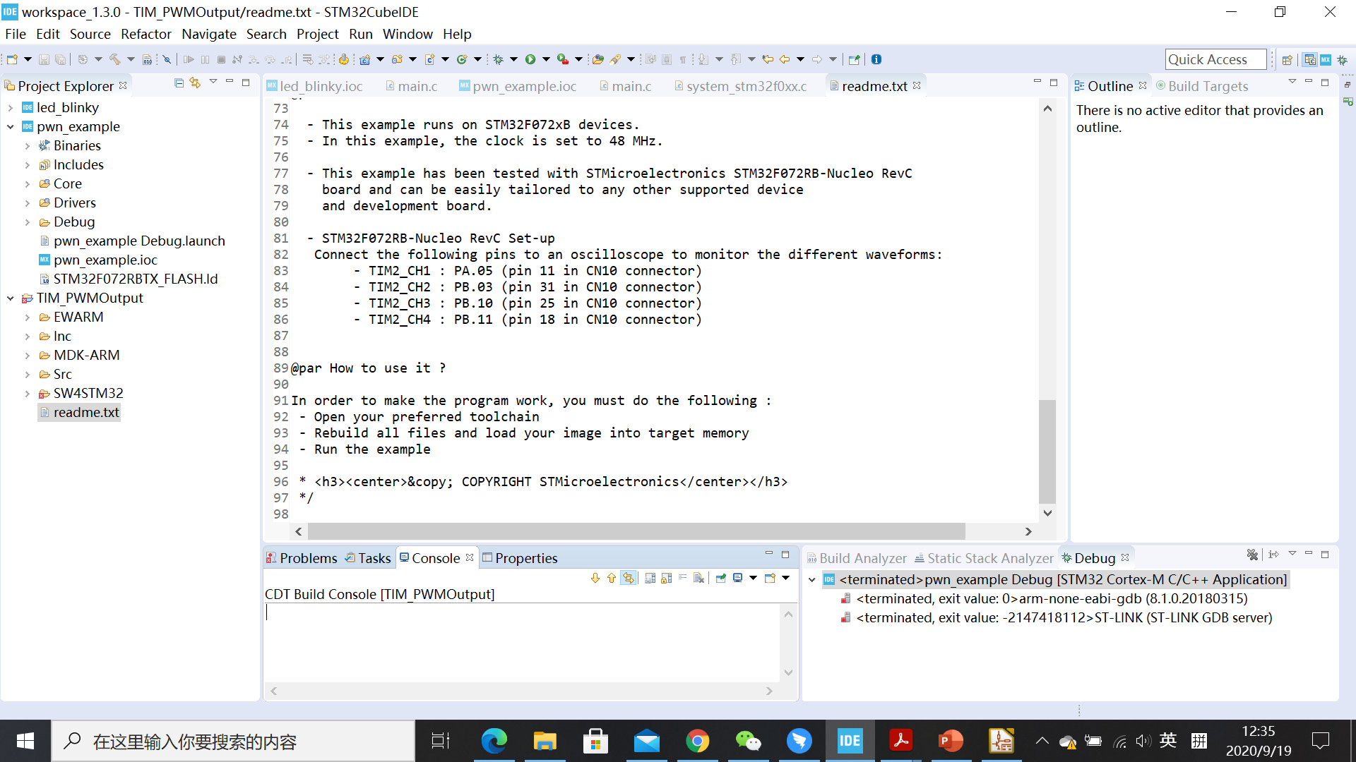
STM32CubeIDE

Slide 14
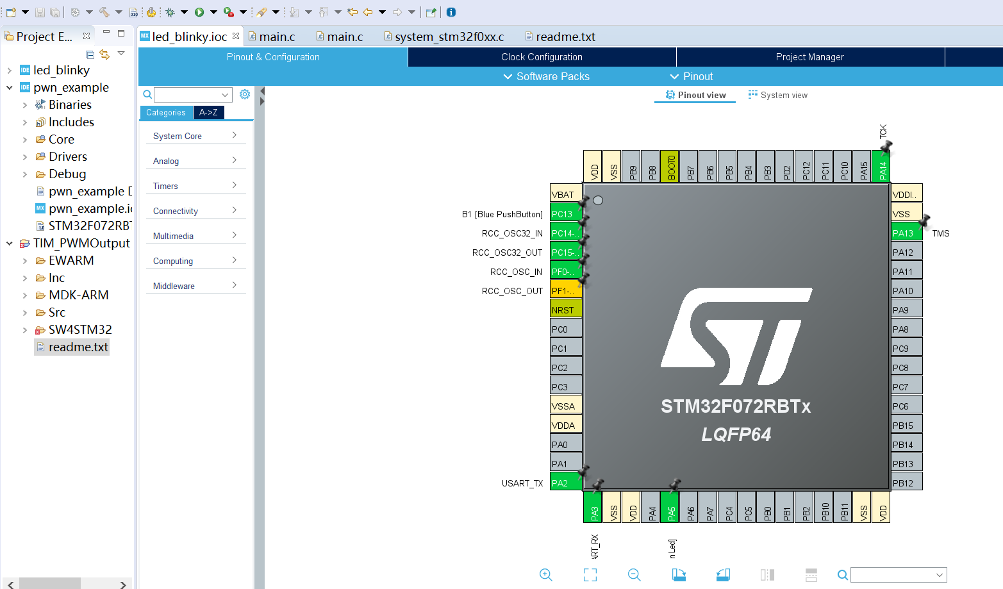

Slide 15
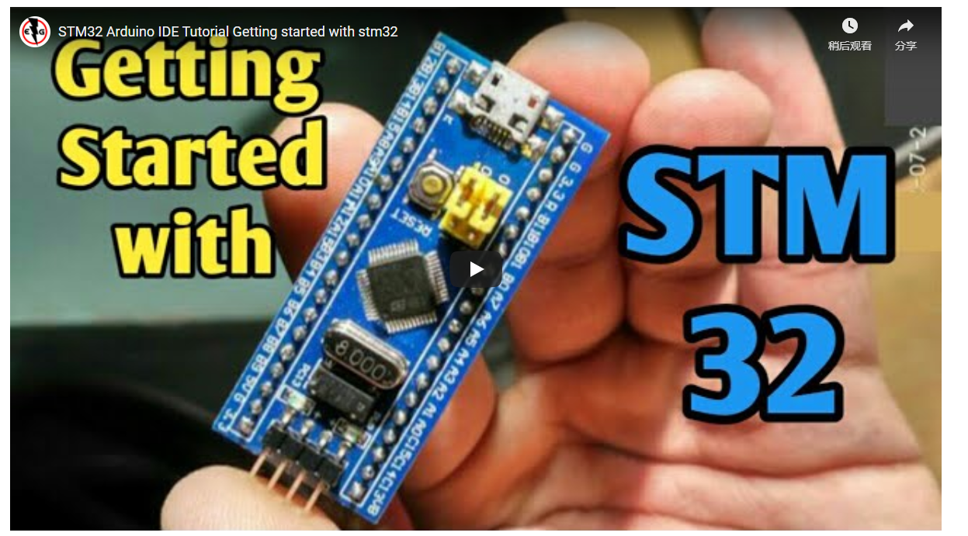
Using Arduino IDE

Slide 16
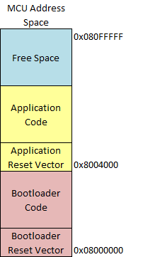
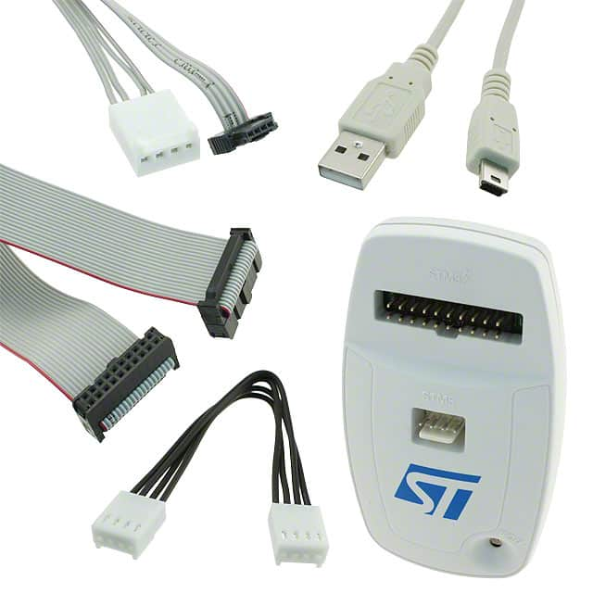
ST-LINK/V2 - SWD/JTAG
Bootloader

Slide 17
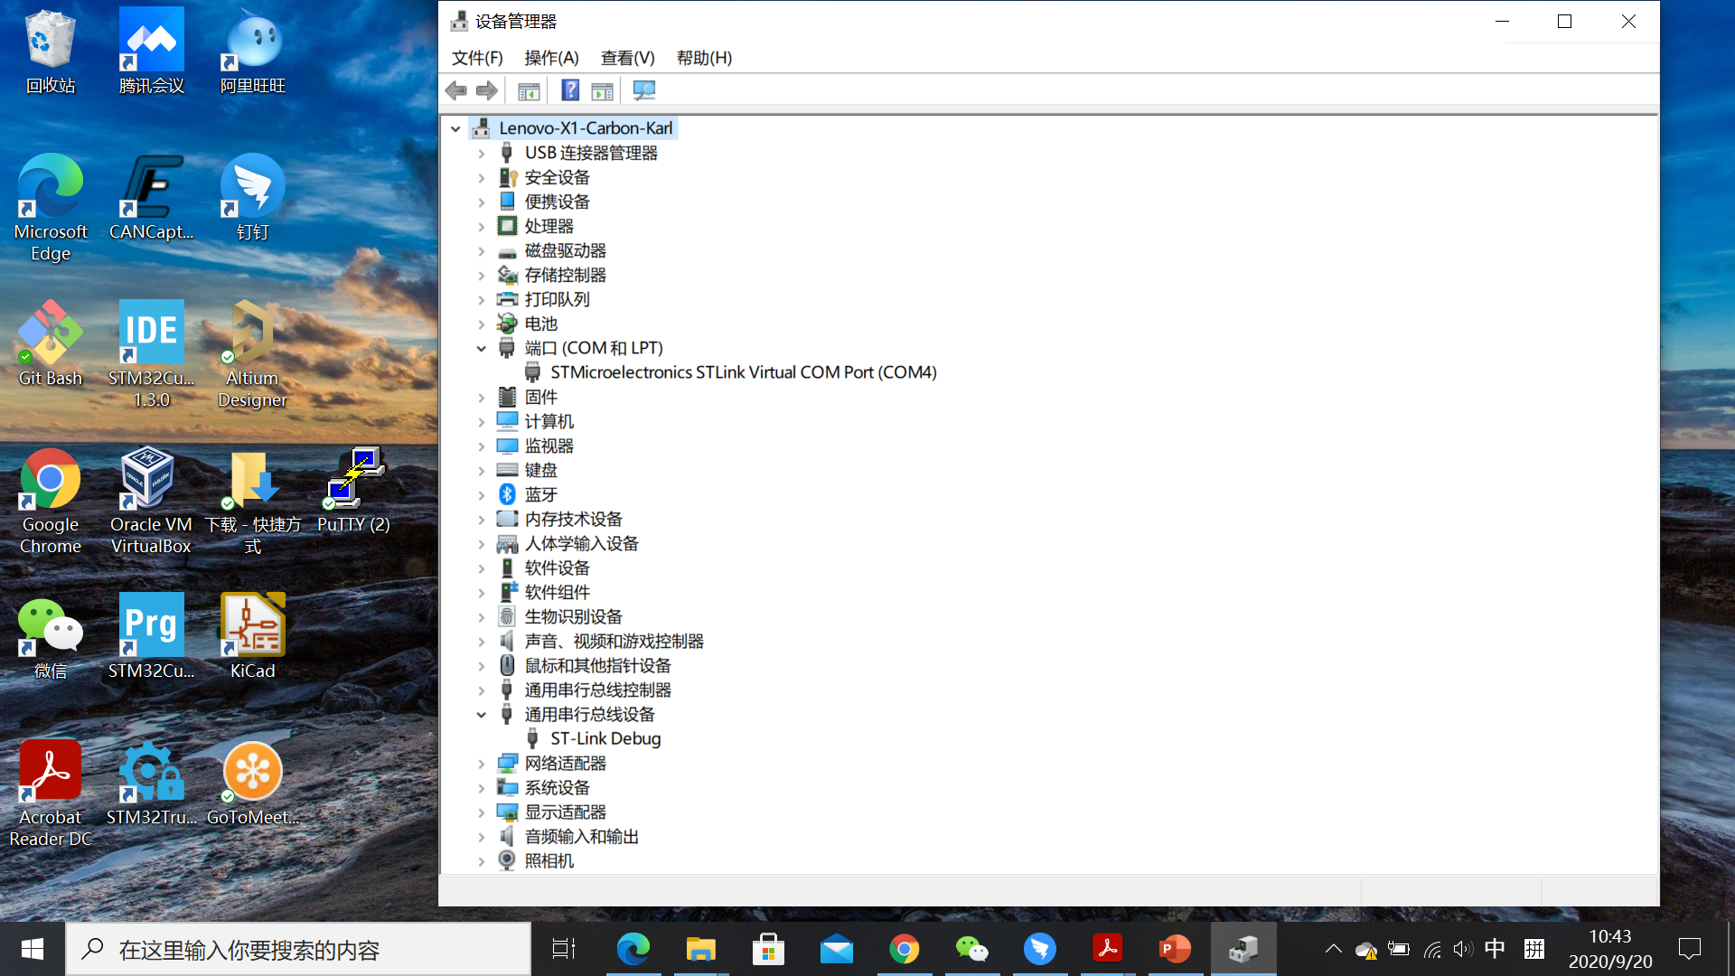
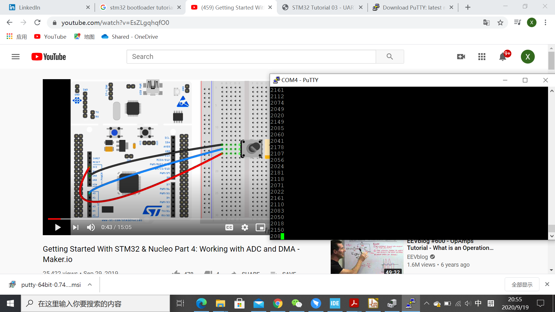

Slide 18
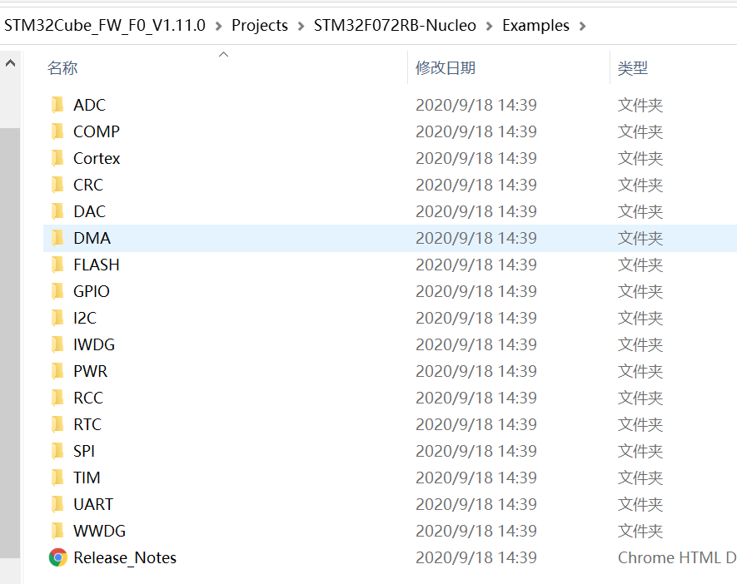
SDK – Software Development Kit

Slide 19
User manual
Getting started with STM32CubeF0 for STM32F0 Series

Slide 20
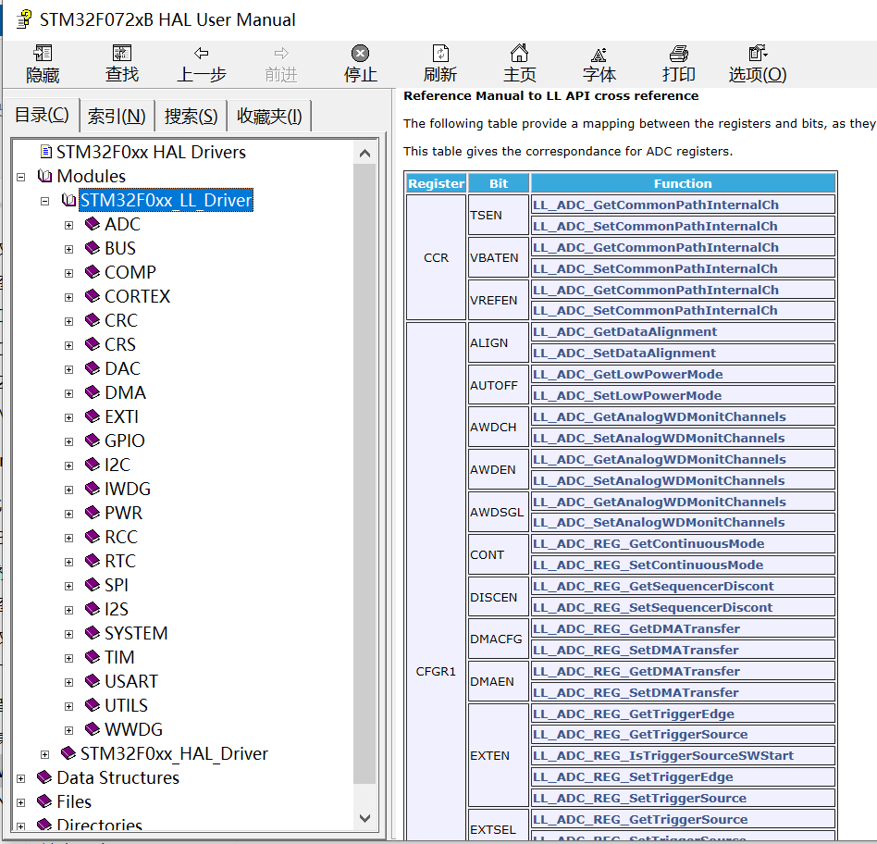

Slide 21
FreeRTOS is designed to be small and simple. The kernel itself consists of only three C files. To make the code readable, easy to port, and maintainable, it is written mostly in C, but there are a few assembly functions included where needed (mostly in architecture-specific scheduler routines).
https://en.wikipedia.org/wiki/FreeRTOS
https://www.freertos.org/features.html
Tesla 电动汽车 vs Self Made Model Car

Slide 22
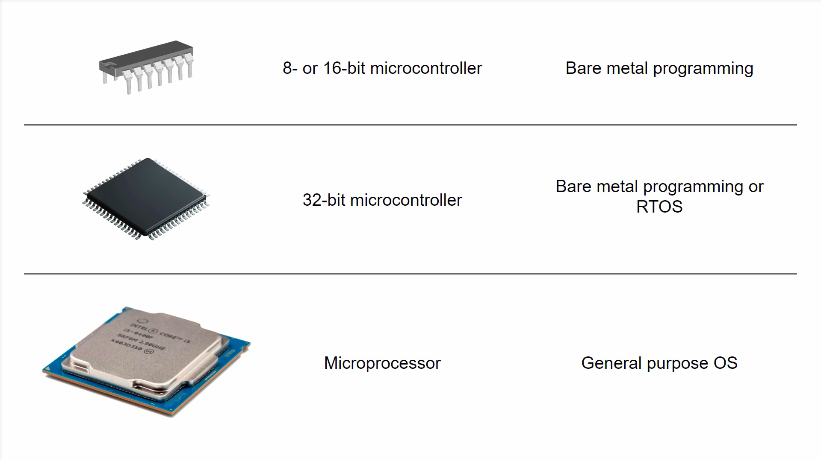
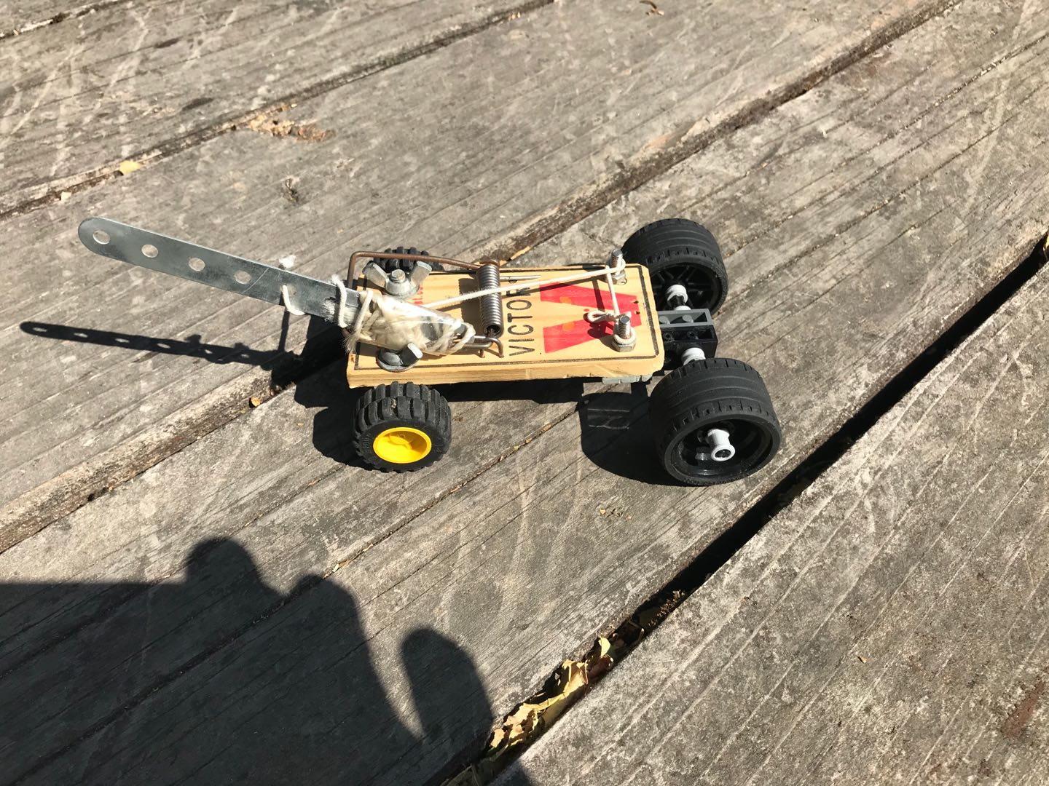
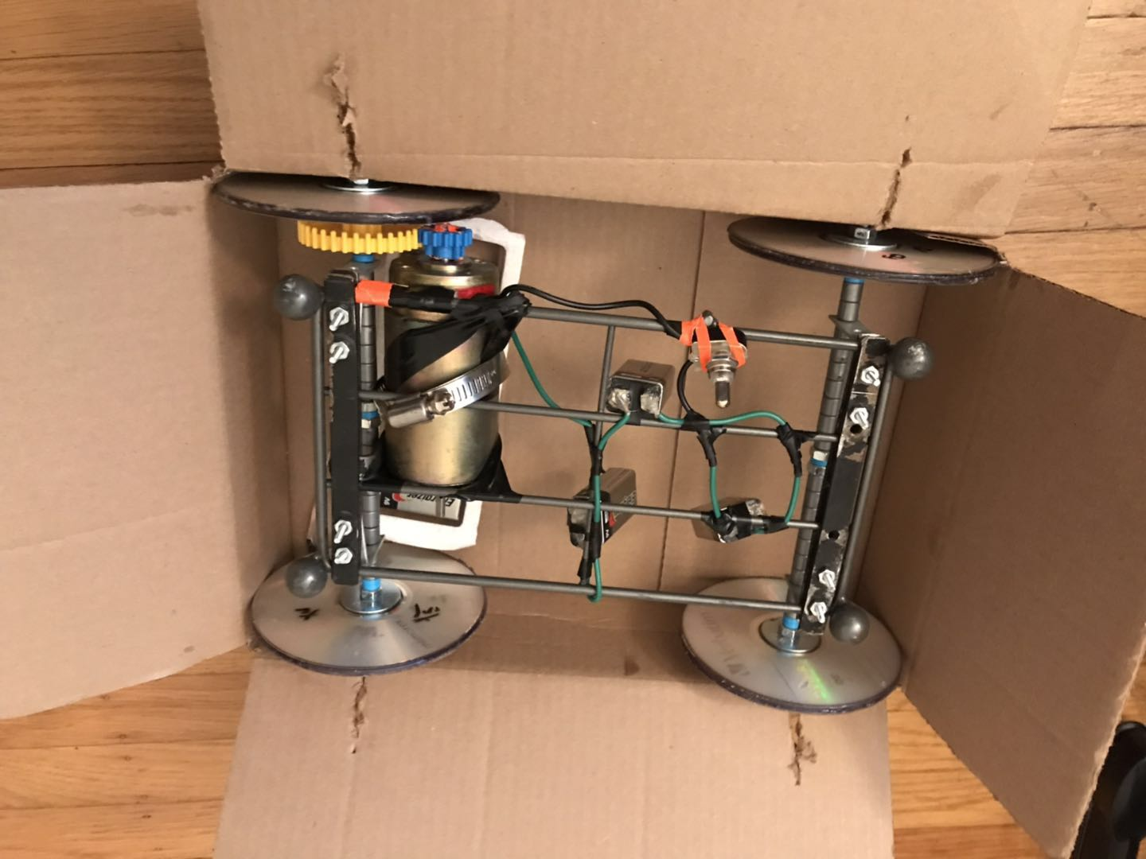
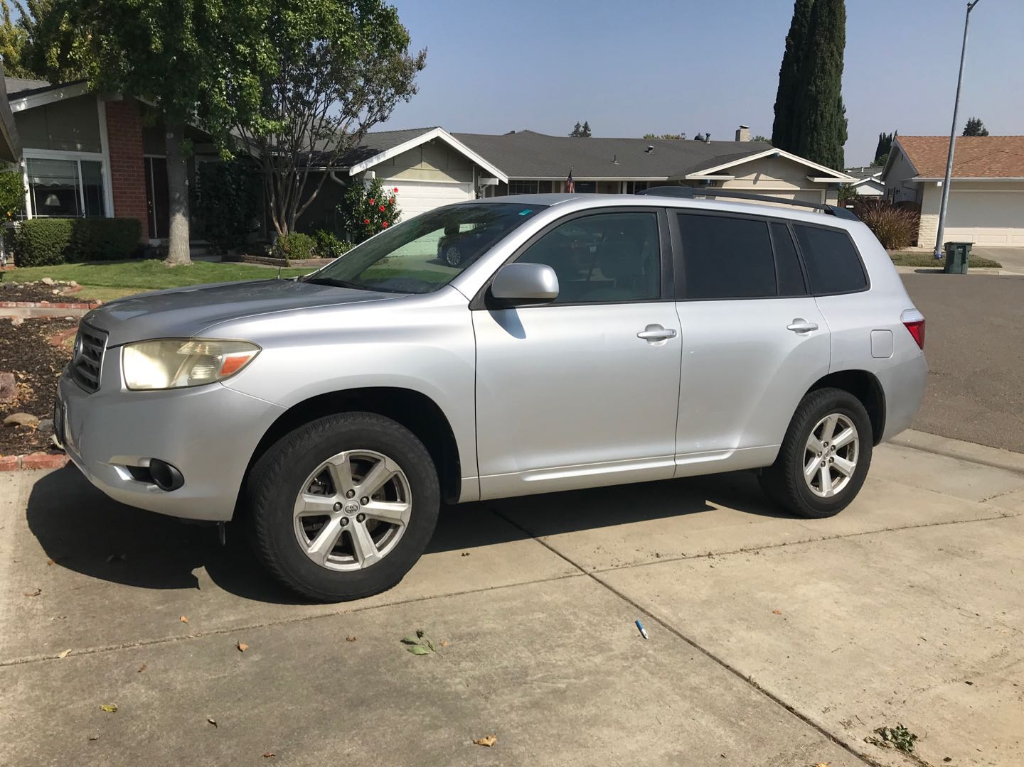

Slide 23
Getting Started With STM32 and Nucleo Part 3:
FreeRTOS - How To Run Multiple Threads w/ CMSIS-RTOS
https://www.youtube.com/watch?v=OPrcpbKNSjU

